Slide 1



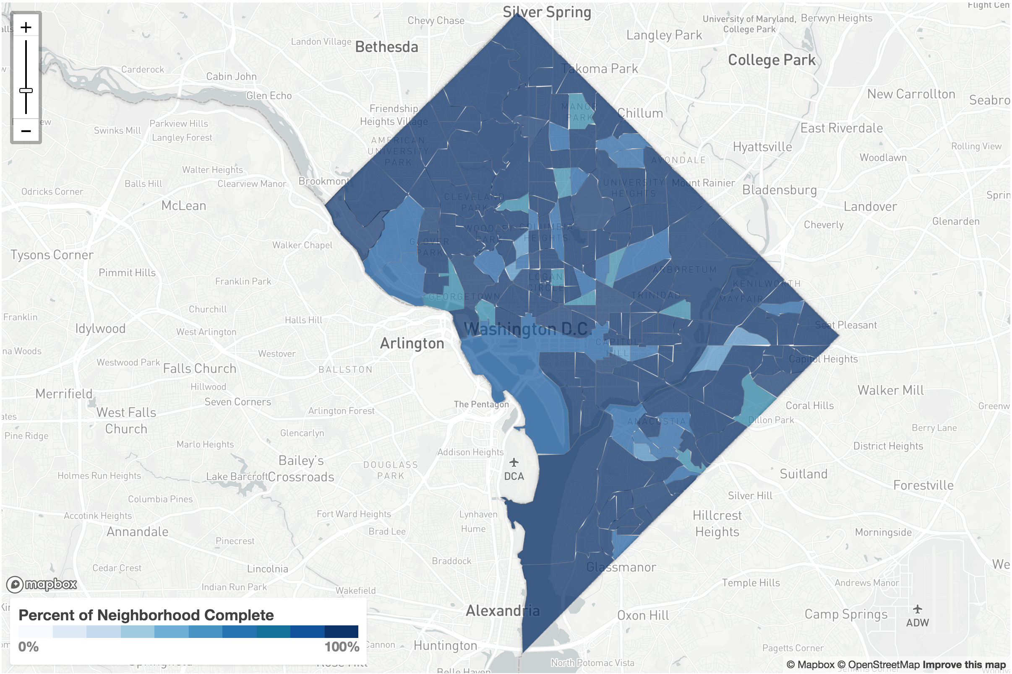
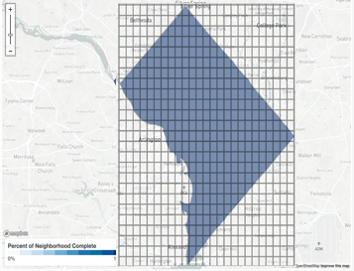
Claire Chu
Bill Kerneckel
Nathan Mowat
Chris Woodard
Accessibility Analysis
A METHOD TO EFFICIENTLY MANAGE CITY INFRASTRUCTURE
Master of Science in Data Science Southern Methodist University, Dallas, TX 75275, USA
DataScience@SMU
Landscape of Accessibility
$27m
$1k
Results
Even though there great environmental, social, and economic benefit to accessibility, until now there hasn’t been an easy way to analyze the sidewalk accessibility of a city. With the revolutionary work of the “Project Sidewalk” team, we are able to use their free sidewalk accessibility data to predict where problem sidewalk areas exist and efficiently allocate the resources to fix them.
We had the highest accuracy for the 25 x 25 grid, which makes sense since, even though our sidewalk data was very granular, our crime data was by city block and our housing data was by neighborhood.
For our crime results, we found that the most important criminal indicator for all four labels was “vehicle theft”.
In 2014, there was $27 million of backlog for sidewalk repairs
Cost of one PCC Wheelchair/Bike Ramp $1000
Accessibility Deficiency
Conclusion
Currently, it can take as long as 30 days to assess sidewalks for repair and even then, sidewalks are only repaired if the budget allows.
75% of Washington D.C. streets have sidewalks on both sides.
In 2014, there was $27 million of backlog for sidewalk repairs.
Washington D.C. stated, they want to Improve the system for prioritizing sidewalk maintenance and repair.
Using random forest classification on the Washington D.C. crime statistics and real estate data, we uncovered a predictive relationship for sidewalk accessibility that is better than random chance. With the methods we outline here, Washington D.C. will be better able to anticipate sidewalk repairs and better allocate resources to minimize these large backlogs.
Increased sidewalk repair efficiency
Better budget forecasting
Prioritization of predicted problem areas
Improve accessibility
Potential expansion of customer base
Path to Prediction
Utilized existing "Project Sidewalk" data, crime statistics, and real estate pricing to predict problem sidewalk areas
Random forest modeling had the best accuracy
Investigated possible regionality
- Left Image: neighborhood zones
- Right Image: 25 x 25 grid overlaid
Our model best predicted the "Curb Ramp” label (95% based on the 50 x 50 grid) and "No Curb Ramp" label (93% based on the 50 x 50 grid)
Future Work
95%
93%
91%
90%
Pedestrian traffic data incorporated with our findings to better analyze priority sidewalks
Sidewalks around schools
Sidewalks near senior citizens
Sidewalks near public transportation
Curb Ramp
No Curb Ramp
Obstacle
Surface Problem

